Slide 1

Vehicle Service & Maintenance Management System
Client – BookMyRepair
Submitted by: Group 5
Jeo Yesudas
Vamshi Kurra
Hareesh Payankalodath
Nimilitha Narayani Sadaram
Manisha Reddy Chinthalapani

Slide 2
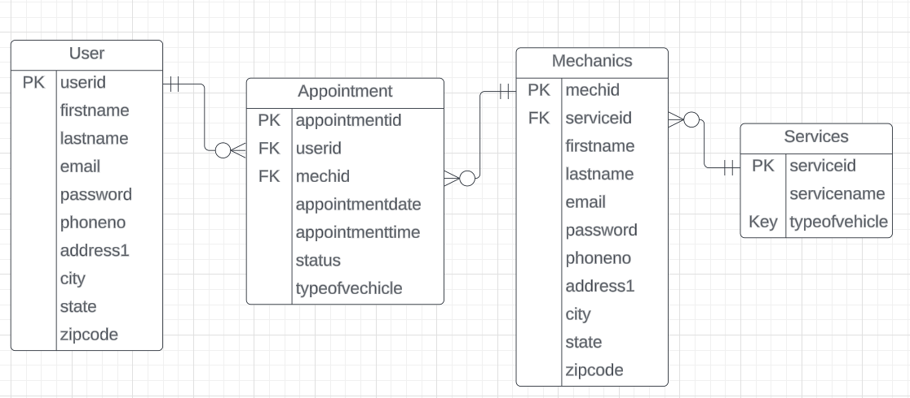
ERD

Slide 3
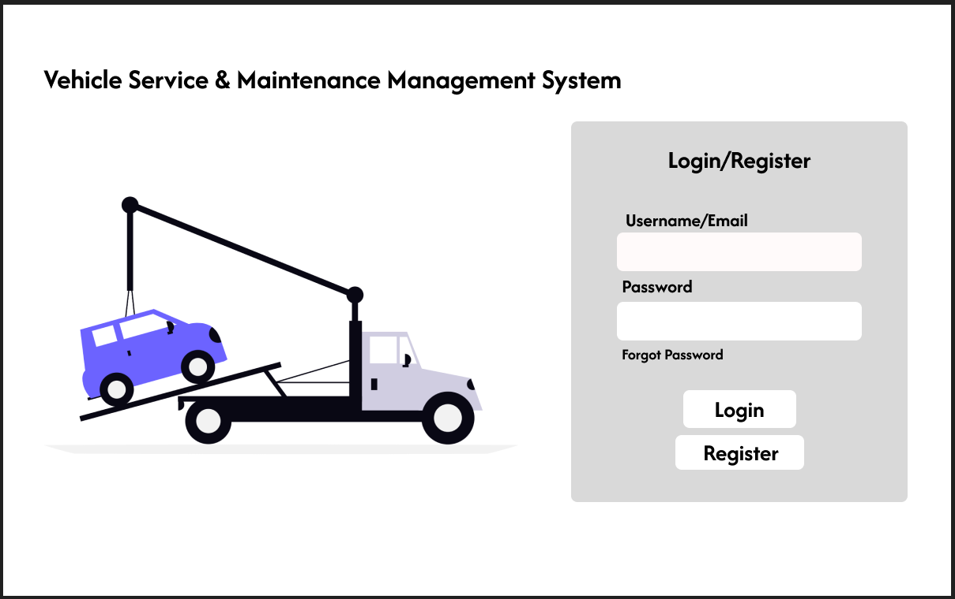
Login Screen

Slide 4
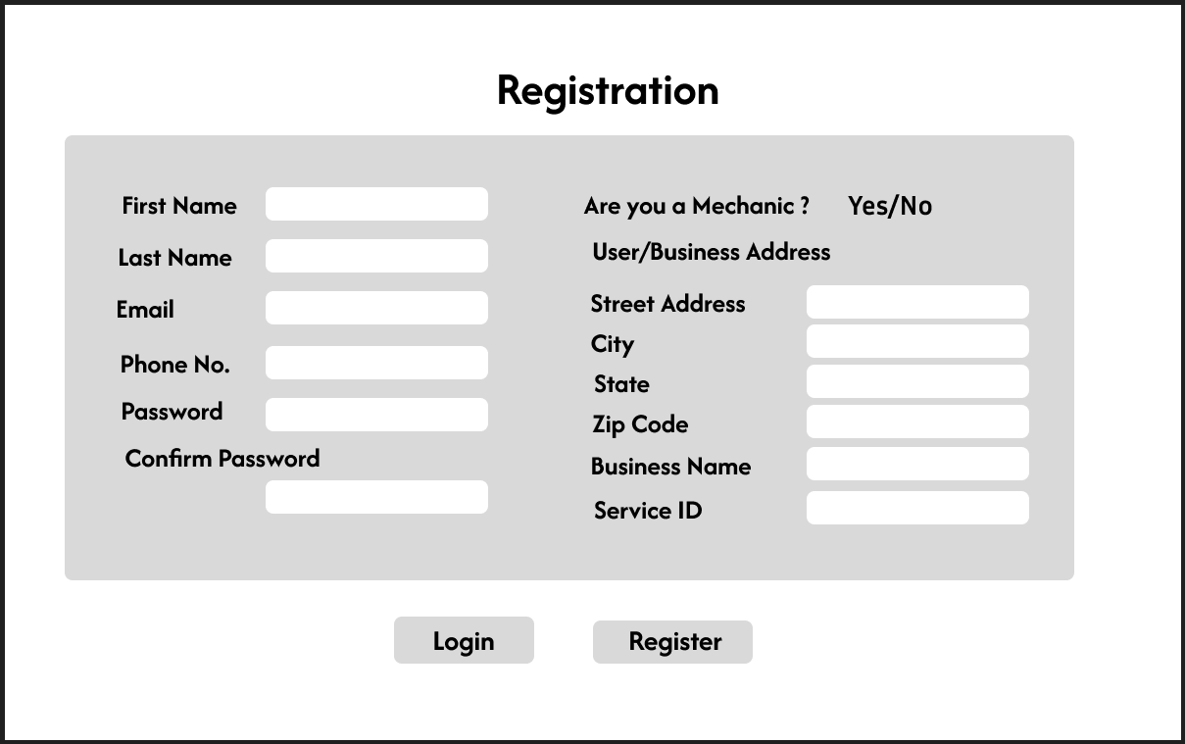
Registration Page

Slide 5
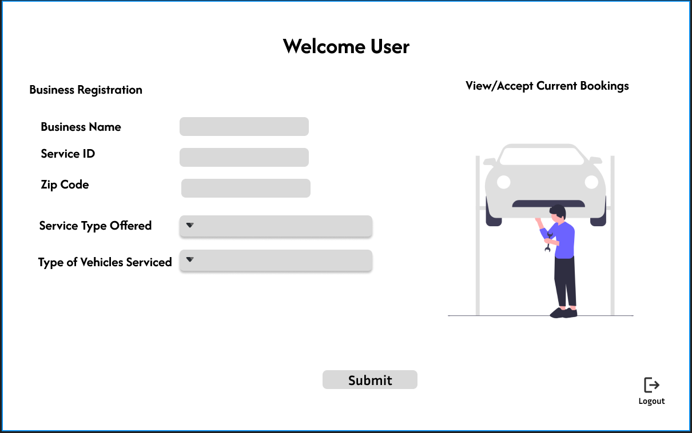
Mechanic Dashboard

Slide 6
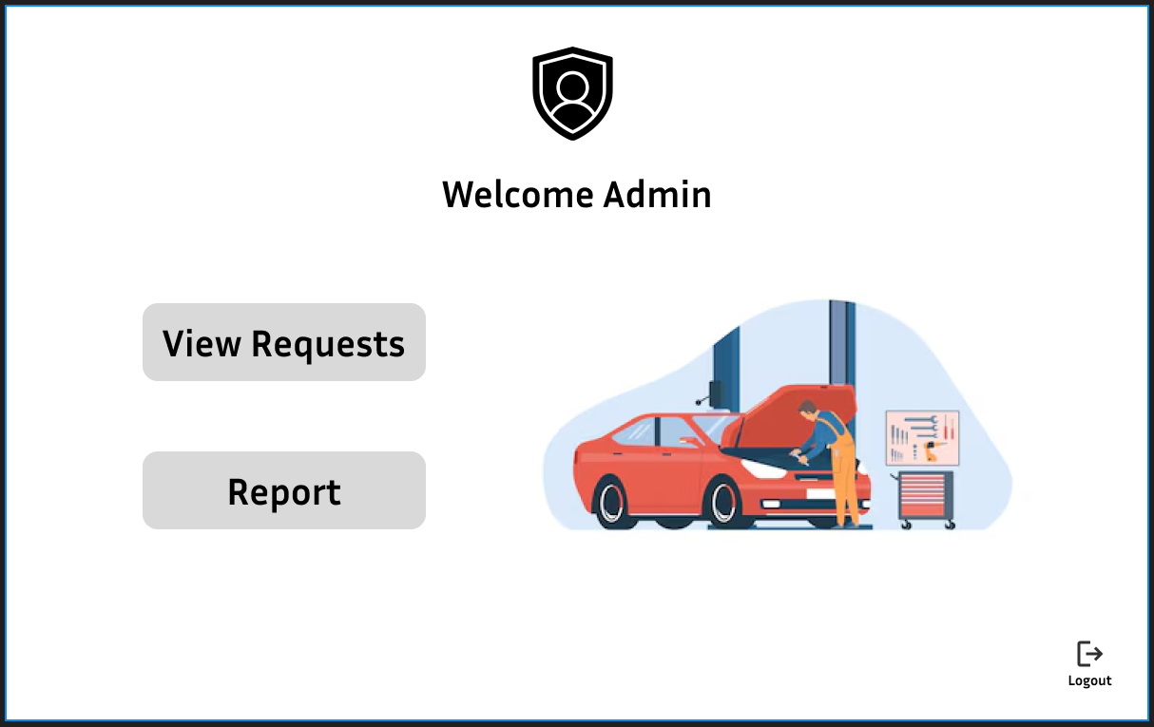
Admin Dashboard

Slide 7
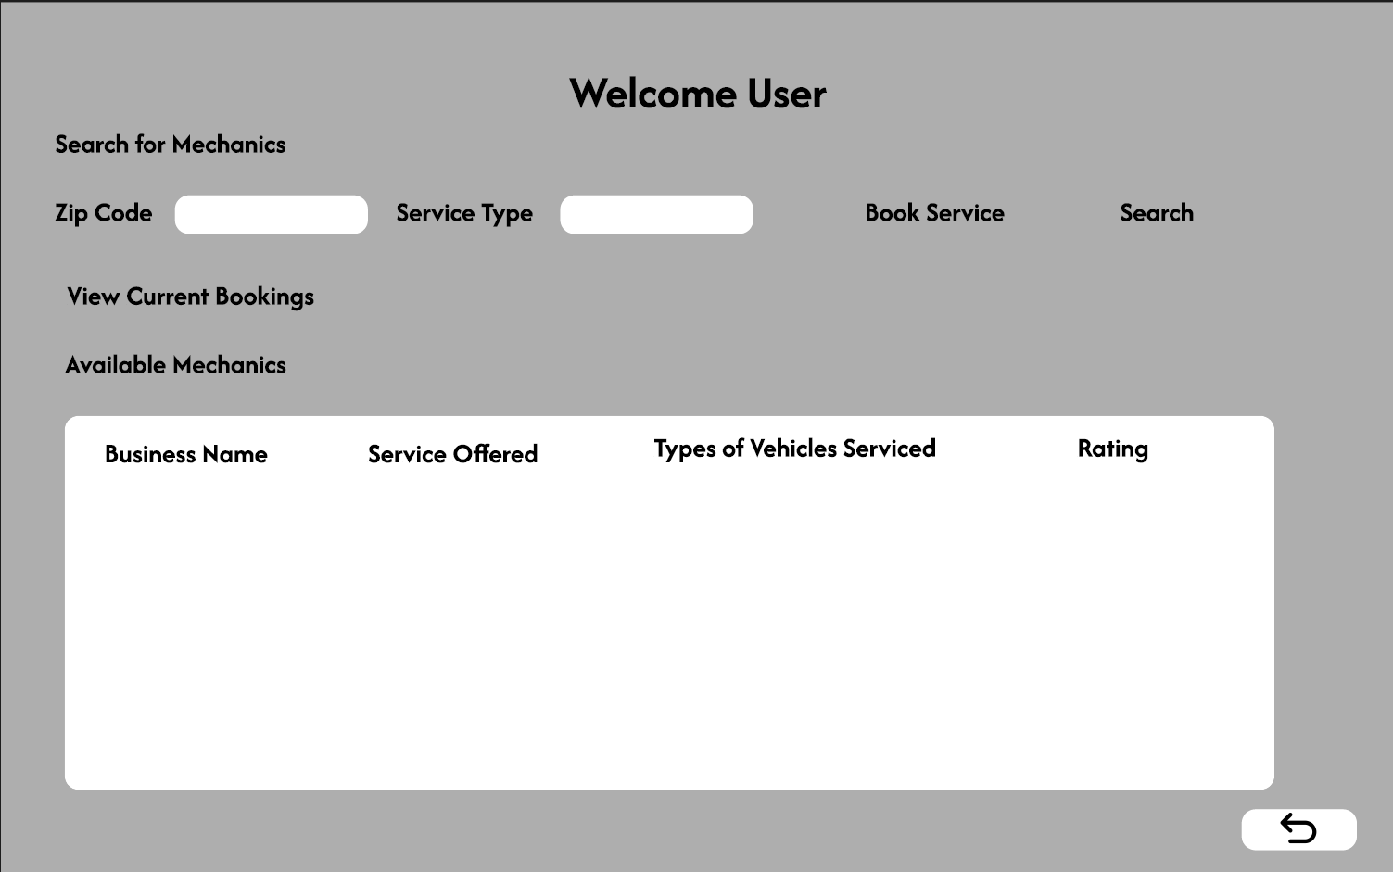
User Dashboard

Slide 8
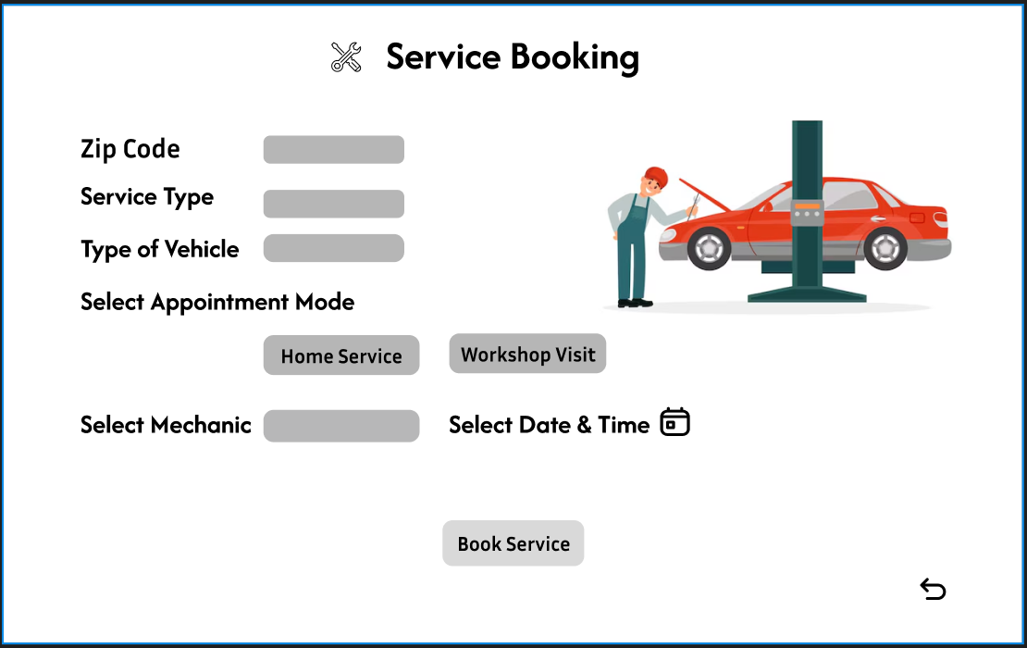
Service Booking Screen

Slide 9
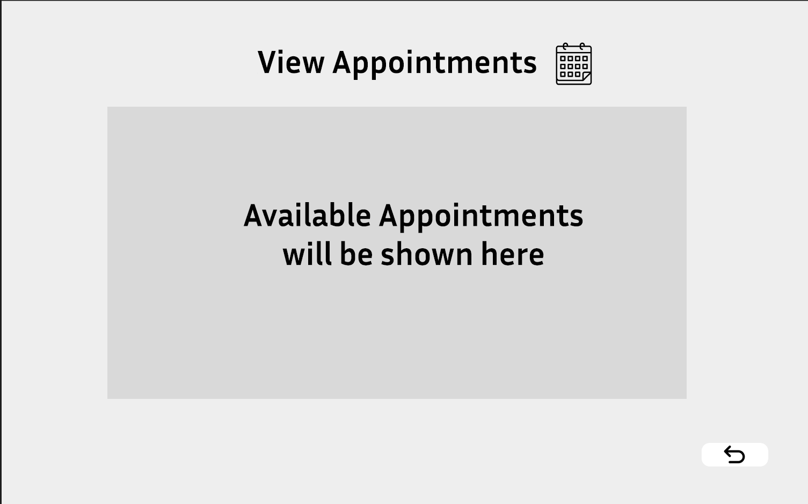
Mechanic Appointments Screen

Slide 10
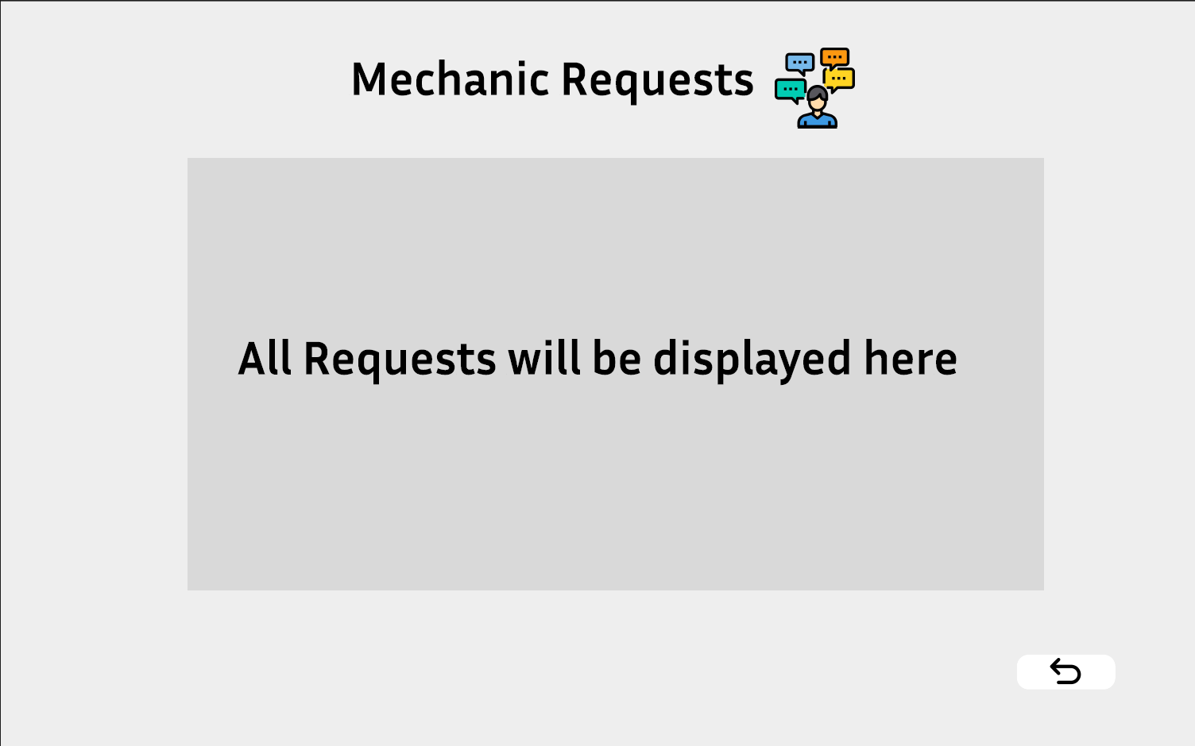
Mechanic Requests Screen

Slide 11
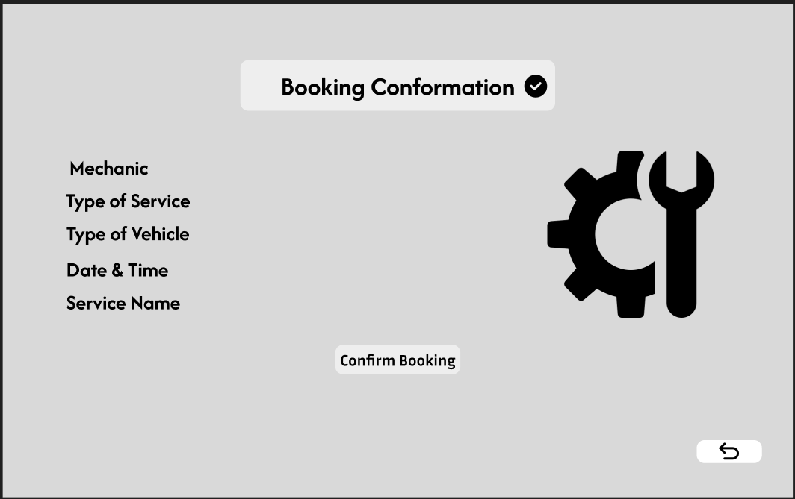
Appointment Booking Conformation Screen

Slide 12
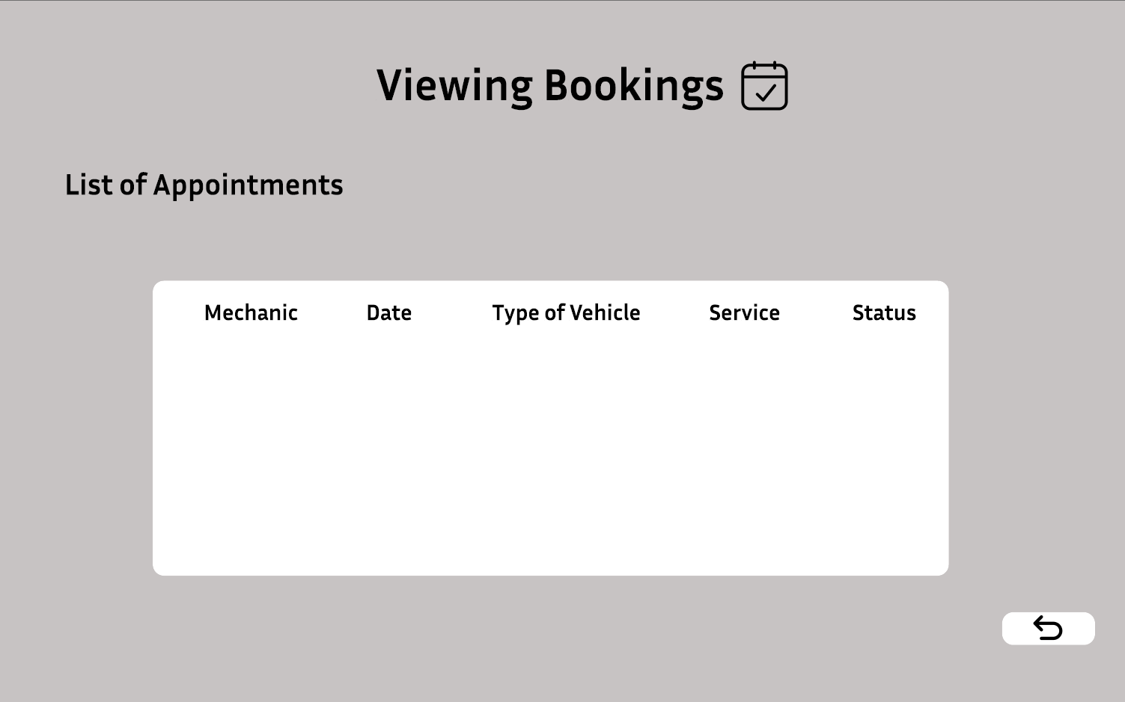
Users Appointments Booked Screen

Slide 13
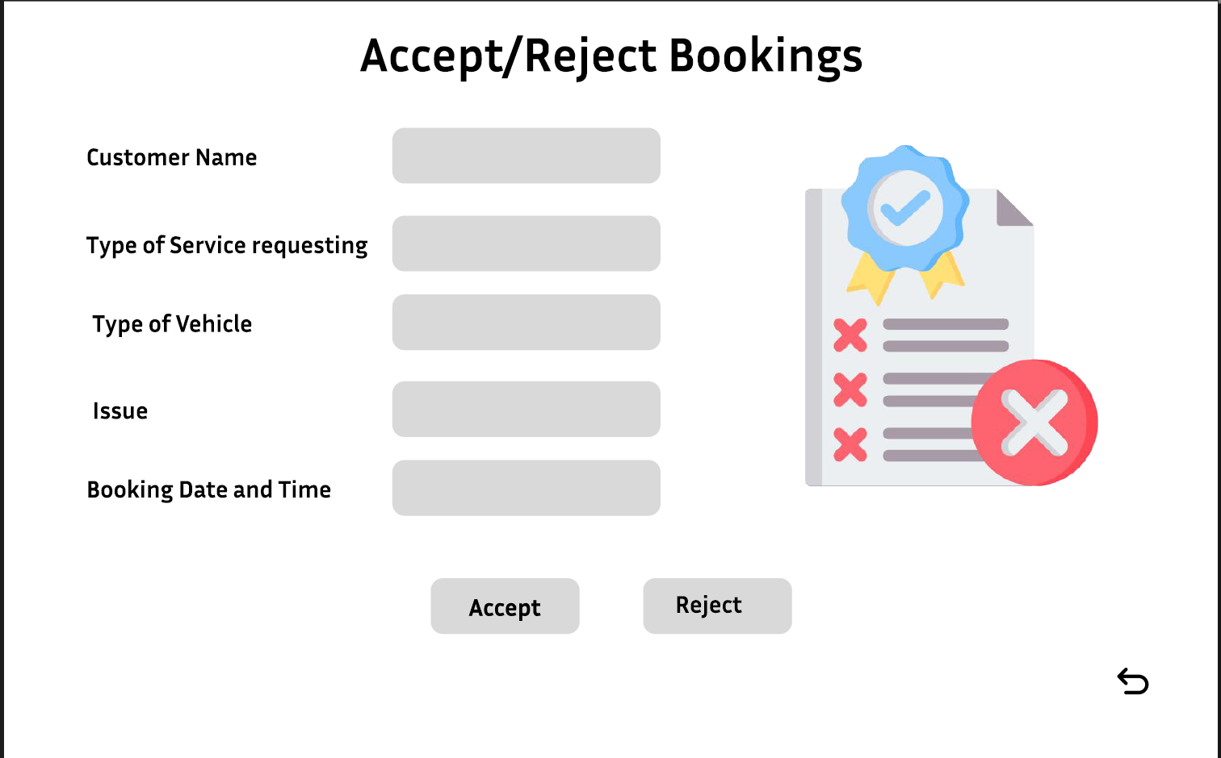
Admin Approval Screen

Slide 14
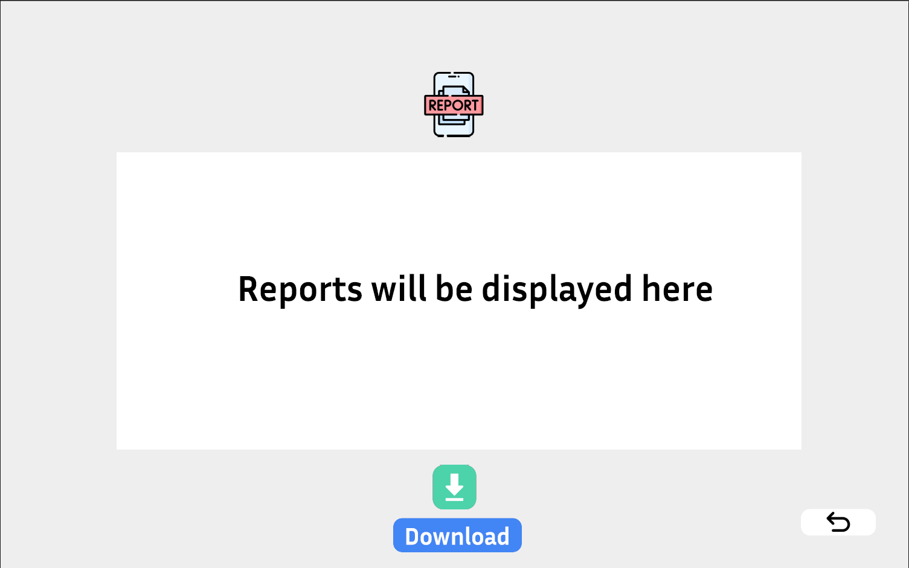
Reports Screen

